Slide 1
BODY TEMPERATURE
Body Temperature reflects the balance between the heat produced and the heat lost from the body , and is measured in the units called degrees .
Temperature can be expressed as Cand F.
Normal is 37*C and 98.6*F
Measured under tongue , axilla and rectum.
By
Dr.Mahadevi A.L
Dept of Physiology

Slide 2
VARIATIONS OF BODY TEMPERATURE
Human body temperature varies.
It depends on –
(A) sex, age, time of day, exertion level, health status (such as illness and menstruation),
( B) what part of the body the measurement is taken
(C) state of consciousness (waking, sleeping, sedated), and emotions.
Body temperature is kept in normal range by thermoregulation, in which adjustment of temperature is triggered by the central nervous system.

Slide 3
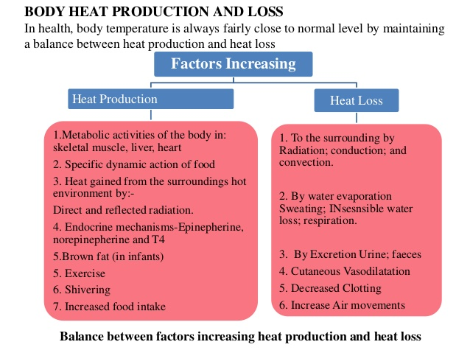

Slide 4
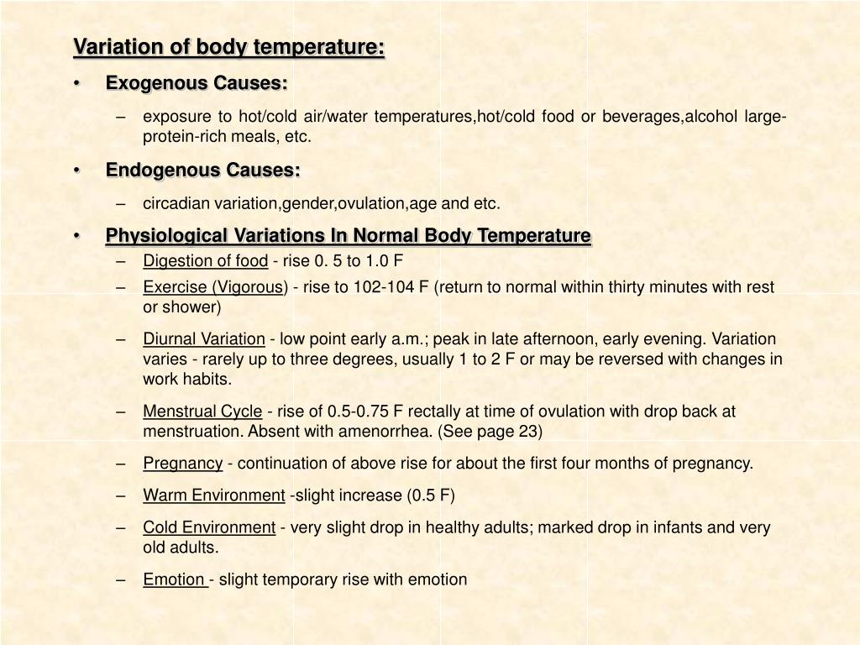

Slide 5
HEAT BALANCE
Regulation of body temperature depends upon the balance between heat produced in the body and the heat lost from the body.
HEAT GAIN OR HEAT PRODUCTION IN THE BODY
Various mechanisms involved in heat production in the body are:

Slide 6
1.Metabolic activities:
Major portion of heat produced in the body is due to the metabolism of food stuffs. It is called heat of metabolism.
Heat production is more during metabolism of fat.
Liver is the organ where maximum heat is produced due to metabolic activities.
2.Muscular activity:
Heat is produced in the muscle both at rest and during activities.
During rest heat is produced by muscle tone.
Heat produced during muscular activity is called heat of activity.
About 80% of heat of activity is produced by skeletal muscle.

Slide 7
3.Role of hormones:
Thyroxine and adrenaline increase the heat production by accelerating the metabolic activities.
4. Radiation of heat from the environment:
Body gains heat by radiation it occurs when the environmental temperature is higher than the body temperature.
5.Shivering:
It refers to shaking of the body caused by rapid involuntary contraction or twitching of muscle as during exposure to cold.
Shivering is a compensatory physiological mechanism in the body, during which enormous heat is produced.

Slide 8
HEAT LOSS FROM THE BODY
Maximum amount of heat is lost from the body through skin and small amount of heat is lost through respiratory system, kidney and GI Tract.
When environmental temperature is less than the body temperature ,heat is lost from the body.
Heat loss occurs by following methods:
1.Conduction:
2.Radiation
3.Convection
4.Evaporation-insensible perspiration
5.Panting

Slide 9
Conduction:
3% of heat is lost from the surface of the body to other objects such as chair or bed by means of conduction.
Radiation:
60% of heat is lost by means of radiation ,i.e. transfer of heat by infrared electromagnetic radiation from body to other objects through the surrounding air.
Convection:
15% of heat is lost from the body to the air by convection.
First the heat is conducted to the air surrounding the body and then carried away by air currents i.e. convection.

Slide 10
Evaporation-insensible perspiration:
When water evaporates heat is lost.
22% of heat is lost through evaporation of water.
Normally small quantities of water is continuously evaporated from skin and lungs. We are not aware of it. So it is called the insensible perspiration or insensible water loss.
It is about 50ml/hr.
When body temperature increases, sweat secretion is increased and water evaporation is more with more of heat loss.
Panting:
It is the rapid shallow breathing ,associated with dribbling of more saliva.
In some animals like dogs which do not have sweat glands ,heat is lost by evaporation of water from lungs and saliva by means of panting.

Slide 11
REGULATION OF BODY TEMPERATURE
Body temperature is regulated by hypothalamus, which sets the normal range of body temperature.
The set point under normal physiological conditions is 37*F.
Hypothalamus has two centers which regulate the body temperature.
1.Heat loss center
2.heat gain center

Slide 12
HEAT LOSS CENTER
situated in preoptic nucleus of anterior hypothalamus.
Neurons in preoptic nucleus are heat sensitive nerve cells, which are called thermoreceptors.
Stimulation of preoptic nucleus results in cutaneous vasodilatation and sweating.
Removal or lesions of this nucleus increases the body temperature.

Slide 13
HEAT GAIN CENTER
It is otherwise known as heat production center.
Situated in posterior hypothalamic nucleus.
Stimulation of posterior hypothalamic nucleus causes shivering.
The removal or lesions of this nucleus leads to fall in body temperature.

Slide 14
MECHANISM OF TEMPERATURE REGULATION
When body temperature increaseas
Blood temperature also increases
Blood stimulates thermoreceptor
Now it brings the temperature to normal by two mechanisms
i. Promotion of heat loss
Increasing the secretion of sweat
Inhibiting the sympathetic centres in posterior hypothalamus( this cause cutaneous vasodilation, so blood flow through skin causing Excess sweating.
ii. Prevention of heat production
By shivering and chemical reaction.

Slide 15
When body temperature decreases:
It is brought back to normal by two mechanisms.
1. prevention of heat loss
2.promotion of heat production
1. prevention of heat loss
When body temperature decreases, sympathetic centers in posterior hypothalamus cause cutaneous vasoconstriction.
This leads to decrease in blood flow to skin and so the heat loss is prevented.

Slide 16
2. promotion of heat production
It is promoted by two ways:
i. shivering:
When body temperature is low, the heat gain stimulates the primary motor center for shivering, situated in posterior hypothalamus near the wall of the third ventricle and shivering occurs.
During shivering ,enormous heat is produced because of severe muscular activities.
ii. increased metabolic reactions
Sympathetic centers which are activated by heat gain center, stimulate secretion of adrenalin and noradrenalin.

Slide 17
These hormones particularly adrenalin increases the heat production by accelerating cellular metabolic activities.
Simultaneously ,hypothalamus secretes thyrotropin releasing hormone .it causes release of TSH from pituitary. It in turn , increases release of thyroxine from thyroid.
Thyroxine accelerates the metabolic activities in the body and this increases heat production.
Chemical thermogenesis:
It is the process in which heat is produced in the body by metabolic activities induced by hormones.

Slide 18
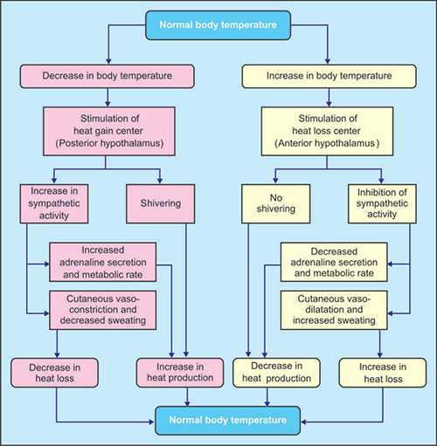

Slide 19
APPLIED PHYSIOLOGY
HYPERTHERMIA-FEVER
Elevation of body temperature above the set point is called hyperthermia, fever, or pyrexia.
Fever itself is not an illness. but it is an important sign of something going wrong in the body. it is the part of the body response to disease.
Fever plays an important role in helping the body fight the diseases, particularly the infections.
Classification of fever:
i. Low grade fever- when the body temperature rises to 38*C to 39*C
ii. Moderate grade fever- when the temperature rises to 39*C to 40*C
iii. High grade fever- when the temperature rises above 40*C to 42*C.

Slide 20
Hyperpyrexia
It is the rise in body temperature beyond 42*C(107*F)
It results in damage of body tissues.
Further increase in temperature becomes life threatening.
Causes of fever:
i. infection :
Certain substances(pyrogens) released from bacteria or parasites affect the heat regulating system in hypothalamus, resulting in the production of excess heat and fever.
ii. Hyperthyroidism:
Increased BMR during hyperthyroidism causes fever.
iii. Brain lesions:
When lesions involves temperature regulating centers, fever occurs.
iv. Diabetes insipidus:
In this condition fever occurs ,without any apparent cause

Slide 21
Signs and symptoms
It depends upon the causes of fever:
Headache
Sweating
Shivering
Muscle pain
Dehydration
Loss of appetite
General weakness
Hyperpyrexia may result in:
Confusion
Hallucinations
Irritability
convulsions

Slide 22
HYPOTHERMIA
Decrease in body temperature below 35*C(95*F) is called hypothermia.
It is considered as the clinical state of subnormal body temperature, when the body fails to produce enough heat to maintain the normal activities.
The major set back of this condition is the impairment of metabolic activities of the body.
When the temperature drops below 31*C(87.8*F), it becomes fatal.
Elderly persons are more susceptible for hypothermia.

Slide 23
Classification of hypothermia:
It is classified into three categories:
i. Mild hypothermia:
When the body temperature falls to 35*C to 33*C(95*F to 91.4*F)
ii. Moderate hypothermia:
When the body temperature fall to 33*C to 31*C(91.4*F to 87.8*F)
iii. Severe hypothermia:
When the body temperature falls below 31*C(87.8*F)

Slide 24
Causes of hypothermia:
Exposure to cold temperatures
Immersion in cold water
Drug abuse
Hypothyroidism
Hypopituitarism
Lesion in hypothalamus
Hemorrhage in certain parts of the brainstem, particularly pons.

Slide 25
Signs and symptoms
i. Mild hypothermia:
Uncontrolled intense shivering occurs
The affected person manage by self
But the movements becomes less coordinated
The chillness causes pain and discomfort.
ii. Moderate hypothermia:
Shivering slows down or stops but the muscles becomes stiff.
Mental confusion and apathy(lack of feeling or emotions) occurs.
Respirations becomes shallow followed by drowsiness.
Pulse becomes weak and blood pressure drops.
Sometimes a strange behaviour develops.

Slide 26
iii. Severe hypothermia:
The person feels very weak and exhausted with incoordination and physical disability.
The skin becomes chill and its color changes to bluish gray.
Eyes are dilated
The person looses consciousness gradually.
Breathing slows down , followed by stiffness of arms and legs
Pulse becomes very weak and blood pressure becomes decreases very much, resulting in unconsciousness.
Further drops in body temperature leads to death.

